Slide 1
Horizontal Scaling
Load Balancing required
RESILIENT
Network calls (RPC)
Data inconsistency
Scales well as users increase
Vertical Scaling
N/A
Single point of failure
Inter- process communications
Consistent Data
Hardware limit

Slide 2
Consistent Hashing
Request Id -> h(r1)
1 / M
Server 0
h1(0) % M
Assign server to positions
Hash request ID, and find closest server
2nd hash table, taking into account virtual servers, to load balance equally
Each servers maps to multiple points
Works well only when many servers
S0
H1(1) % M
Server 1
SM
S1
H1(2) % M
Server 2
Server 3
H1(3) % M
S3
S2
Server M
H1(M) % M

Slide 3
Message/ Task Queues
20
Server 0
ID | Contents | Done
1 | Ham | Y
2 | Cheese | N
3 | Plain | N
4 | … | …
Heartbeat
Notifier / Load Balancing
8
Server 1
3
Server 2
If server doesn’t respond, notifier finds ids to dead server
Redistributes orders to other servers
Load balancing/ consistent hashing deals with duplicates, not sent to multiple servers
9
Server 3
11
Features
Assignment / notification
Load balancing
Heartbeat
persistence

Slide 4
Monolithic vs MicroServices
Monolithic
Can have many machines
Simpler to maintain
Less Complex
Don’t need to duplicate for setting up tests, connections
Procedure calls faster, not RPC
Deployments are complicated, have to be monitored every time
Single point of failure, have to restart everything instead of at few points
MicroService
Can have little machines
Easier to scale
Easier for new team members
Parallel development is easier
Fewer parts are hidden when deploying
Not easy to design, needs smart architects

Slide 5
Database Sharding
Consistency
Availability
Can shard by userId, location
Problems
Joins across shards, expensive
Shards are inflexible in number, can use consistent hashing (Memcached)
Create index on shards
Master -> Slave Arch
Writes to master, reads to slaves, slave becomes master if needed

Slide 6
Single point of failure
More Nodes
Master – Slave
Regions
Multiple Load Balancers (Gateway)
Client -> DNS -> LBs -> Nodes -> DBs

Slide 7
Tinder
Store Images as file or Blog (Binary Large Object)
Sessions
Service
Client 1
update(user)
User / token
Matcher
Service
Gateway
Service
Can only sort by 1 Index
Age
Gender
Location
Use
Cassandra/ Dynamo
Sharding, Horizontal Partitioning on location Use master slave arch
Client 2
message(u1, u2)
Profile
Service
Auth
Web socket
Peer 2 Peer Protocol (xmpp)
Instead of
Client Server Protocol (http)
Recommendations
Service
Images
Service
Features
Store Profiles (Images – 5 per User) Store Images as file or Blob (Binary Large Object)
Recommend matches (# of active users)
Note matches (0.1% match)
Direct messaging
DBs
Mutability
Transaction – ACID
Indexes (search)
Access Control
Store as file
Cheaper
Faster
profileId, imageId, FileUrl
To Distributed File Sys

Slide 8
WhatsApp
Web sockets over http long polling
Client 1
Last Seen Service
Logical Sockets mapping
User -> Connection -> Box
Limit of 200 users per chat, limit fan out, for real time
Profile
Service
Gateway 1
Client 2
Image
Service
Parser Service
Sessions Service
Client 3
Maps user -> gateway
Email
Service
Message Queues
Gateway 2
Client 4
route(group Id)
Consistent Hashing to right box
Hash(request Id)
SMS
Service
Group Service
Client 5
Auth Service
Message prioritization
Group Id -> User Id
Retrial
Imdempotent
Ordering
Load Balancer
Features
Group Messaging
Sent, Delivered, Read Receipts
Online/ Last Seen
Image Sharing
Chats are temporary/ permanent
Deprioritize services like seen/read messages under huge loads

Slide 9
Distributed Caching
Why
Avoid Network Call
Avoid computations
Reduce DB load
If cache closer to server, faster, but can be inconsistent between servers (in memory)
Global cache (Redis), can recover when failing, and can scale independently
Write-through
Update cache first, then update DB
Can wait and send to DB in both, for noncritical data, for saving network calls
Not practical for multiple caches
Write-back (performance issues)
Update DB first, then make entry in cache/ or invalidate
When hit cache on GET, then go to db, and also update cache
Hit cache, invalidate entry if it is there
Hybrid
If not critical info, write to cache, wait, and take entries in bulk and write to DB
Eviction Policy
Thrashing – constantly inputting and outputting to cache without using results
Consistency

Slide 10
API Design
Items of importance
Naming
Parameters deficiency
More params for efficiency only
Response object simplicity
Return specific errors messages, for expected errors
Design API request
www.webiste.com/chat_messaging/getAdmins
POST
Request Object
Response
No side effects. If many flags, should break down into separate functions
Doing everything
atomicity
When response is huge
Pagination - Break response into multiple responses, but not stateless
Fragmentation
Do you want perfect consistency?

Slide 11
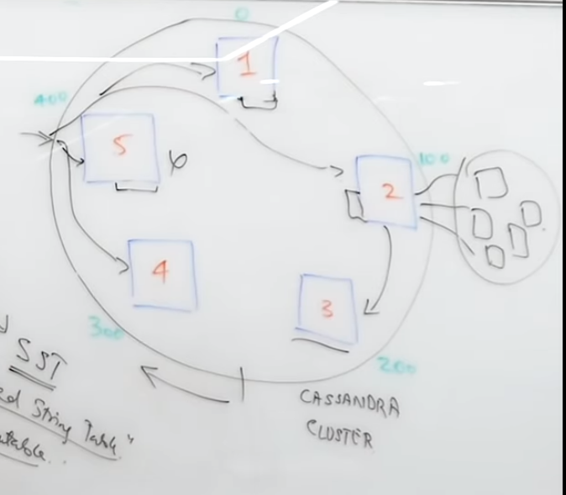
NoSQL
SQL
requires joins which are expensive, no way to efficiently normalize
NoSQL
Flexible schema
insertions and retrievals require the whole blob
Horizontal partitioning built in, build for scale
Build for aggregation, finding metrics
NoSQL – disadvantages
Not built for updates (delete and insert), Consistency, ACID not guaranteed
Not read optimized
Relations are not implicit
Joins are hard
Cassandra
Have n instances
Writes to m servers, where pos through pos + m - 1
Quorum factor of x. For reads, x servers have to return the same value

Slide 12
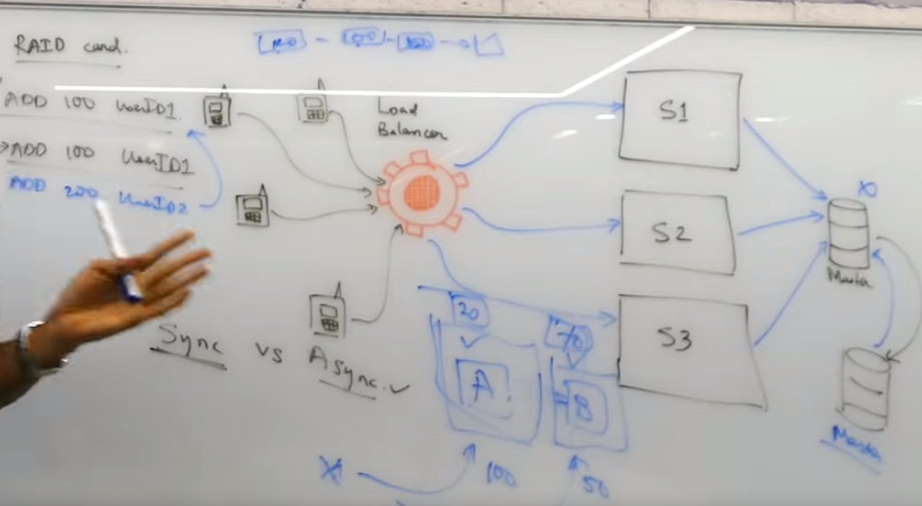
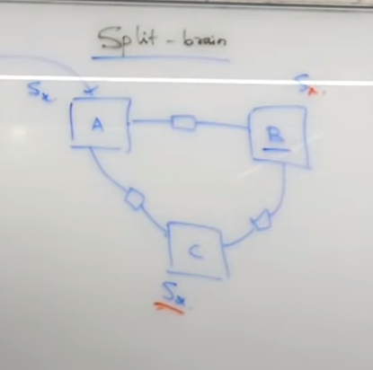
Distributed Consensus
Bottleneck to Master DB
Add slave node, prevent writes to it, only reads
Or make both masters
Add 2 slaves
2 Phase commit, 3 phase commit, MVCC, SAGA

Slide 13
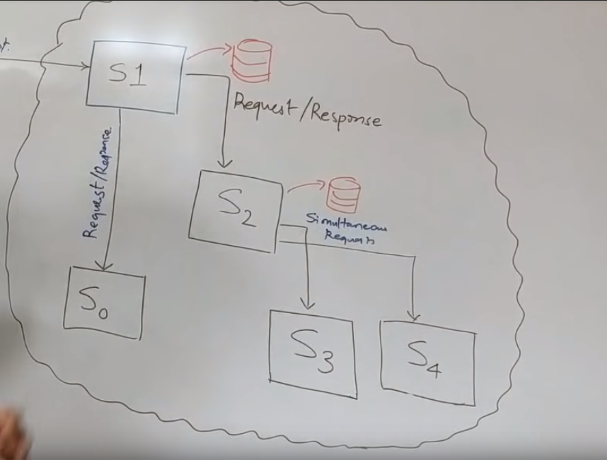
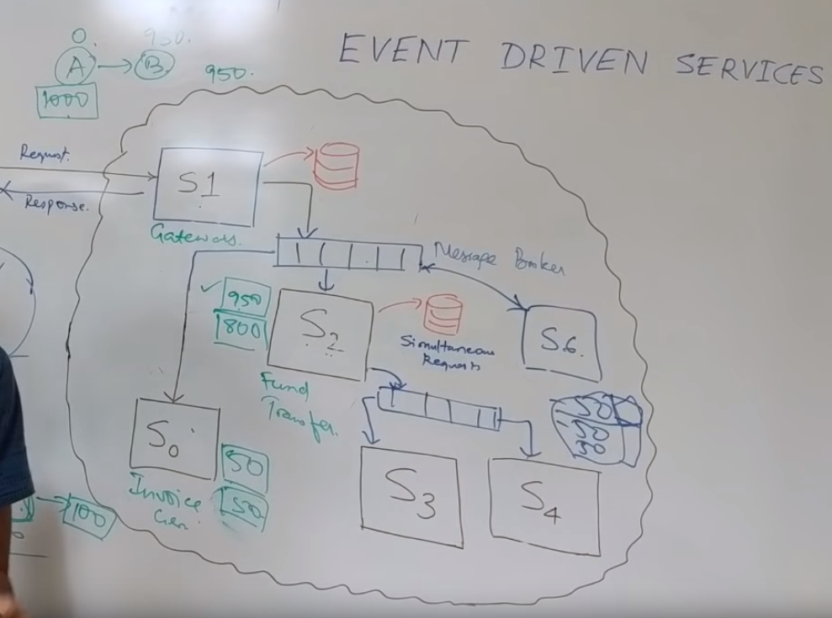
Pub Sub
Use queue
Disadvantage – not enough consistency by default

Slide 14
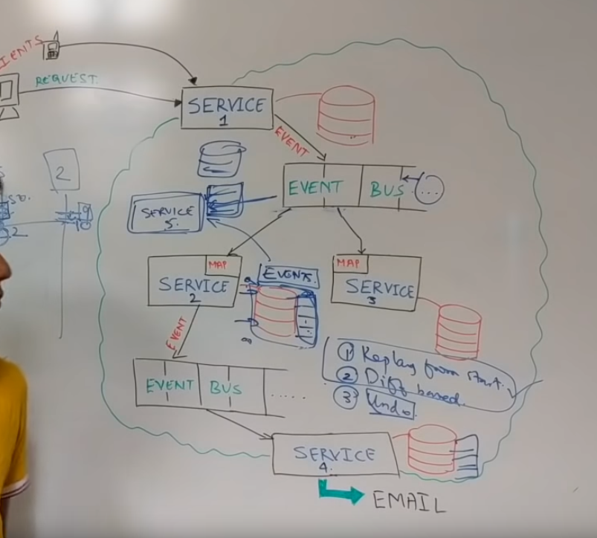
Event Driven Systems
Availability (but lower consistency)
Easy Roll- backs
Replacement
Problems
Consistency
N/A to Gateways
Less control of responses
Compaction
Hidden Slow
Fixing
Replay from Start
Diff based
Undo

Slide 15
Instagram
Image Service
Client 1
Gateway
User Feed Service
Posts Service
Chat Service
Follow Service
Profile Service
Load Balancer
(snapshots)
Features
Store/ Get Images
Like + Comment on Images
Follow someone
Publish a newsfeed
Feature #1
Store/ Get Images
Already cover by Tinder slide
Activity Service
Sessions Service
Feature #4
Publish Newsfeed
Get followers, then posts
Expose API
Get posts by users
Limit # of posts from post service
Pre-compute User feed post service sends event user feed service, get followers, add to each one’s queue
Store in cache
Celebrity posts
Push Batch processing, send 1000 posts every 10 sec (push)
Wait for followers to poll server
Hybrid model – push for normal user, poll for celebrity
Post
ID | text | imageUrl | userId | Time
Feature #2
Like + Comment on Images
Can you comment on a comment?
Can you like a comment?
Design ER diagram and DB tables
Comment
ID | text | time | activityid
Likes
ID | type | active | activityId | UserID | Time
Activity
ID | numLikes
Feature #3
Follow someone
Follow
followerID | FolloweeID | time

Slide 16
Heartbeats
Server 1
If miss one heartbeat,
Mark as critical
If miss 2 heartbeats,
Ask another service to restart
Try 2 way heartbeat, to prevent zombie processes
Can restart itself
Cache snapshots on load balancer
Health services keep track of diffs
Health
Service
Server 2
Load Balancer
Server 3

Slide 17
Tips
Don’t go into detail prematurely
Look for first point to go into detail
Database -> ER diagrams
Do not have a set architecture in mind
KISS
Keep It Simple Stupid
Form your thoughs
Make points without justifications
i.e. choosing a SQL database
Be Tech Aware
Client
Gateway
Server 1
Server 2
Database

